Slide 1
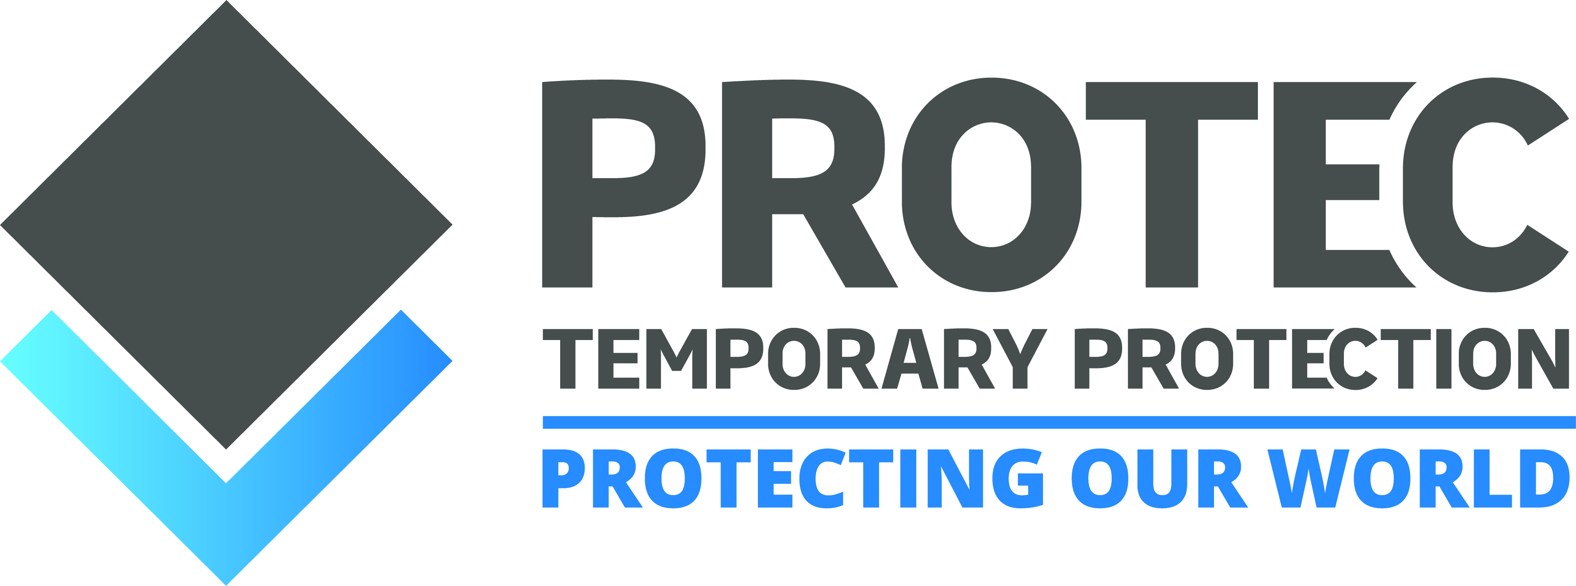
INTRODUCING THE PROPLEX CLOSEDLOOP REMANUFACTURING SCHEME

Slide 2
CREATING A SUSTAINABLE FUTURE

Slide 3
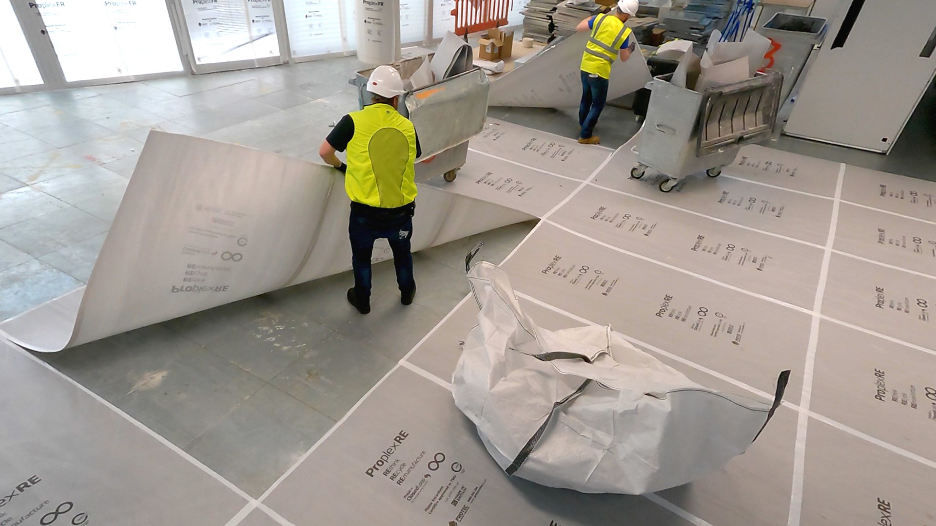
WHAT IS THE PROPLEX CLOSEDLOOP REMANUFACTURING SCHEME?
PROTECTING YOUR PROJECTS AND OUR PLANET
SAVE MONEY and REDUCE CARBON with our Proplex ClosedLoop Remanufacturing Scheme.
Our award-winning scheme recovers used Proplex temporary protection so we can recycle it and remanufacture it into new temporary protection sheets.
For every tonne of Proplex you send back to us for recycling and remanufacturing, the carbon saving is equivalent to 50 mature trees growing for one year.

Slide 4
FEATURES & BENEFITS
Manufactured using 60% post-consumer waste
No longer rely on virgin polypropylene which is a finite resource
Contains half the embodied Carbon of typical 2mm sheets
Helps to achieve your net zero carbon target
Technical performance is the same as our standard Proplex sheets
Simple to specify ProplexRE and be more sustainable
Flame Retardant grade is Certified to Warrington standard TS63
Conforms to the requirements of the JCP for Temporary protection materials so you can use on any site
Recyclable
Part of our Proplex ClosedLoop Remanufacturing Scheme
Manufactured in Britain

Slide 5
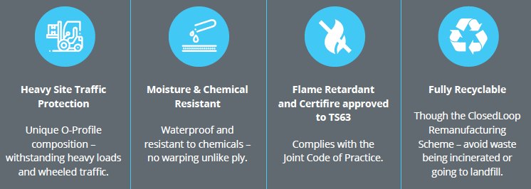
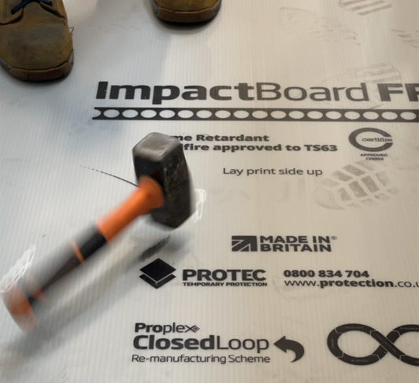
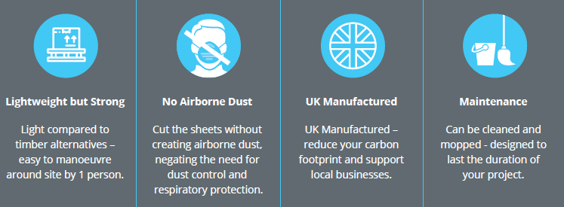
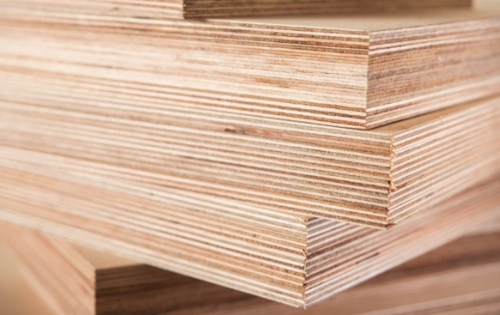
IMPACTBOARDFR VERSUS PLY
The durable, sustainable, flame retardant approved alternative to ply

Slide 6
HOW CAN YOU TAKE PART IN THE PROPLEX CLOSEDLOOP REMANUFACTURING SCHEME?
Specify ProplexRE and the Proplex ClosedLoop Remanufacturing Scheme on all your projects
Order temporary protection
Use protection on-site
Uplift protection and segregate it
We collect it
We recycle & remanufacture

Slide 7
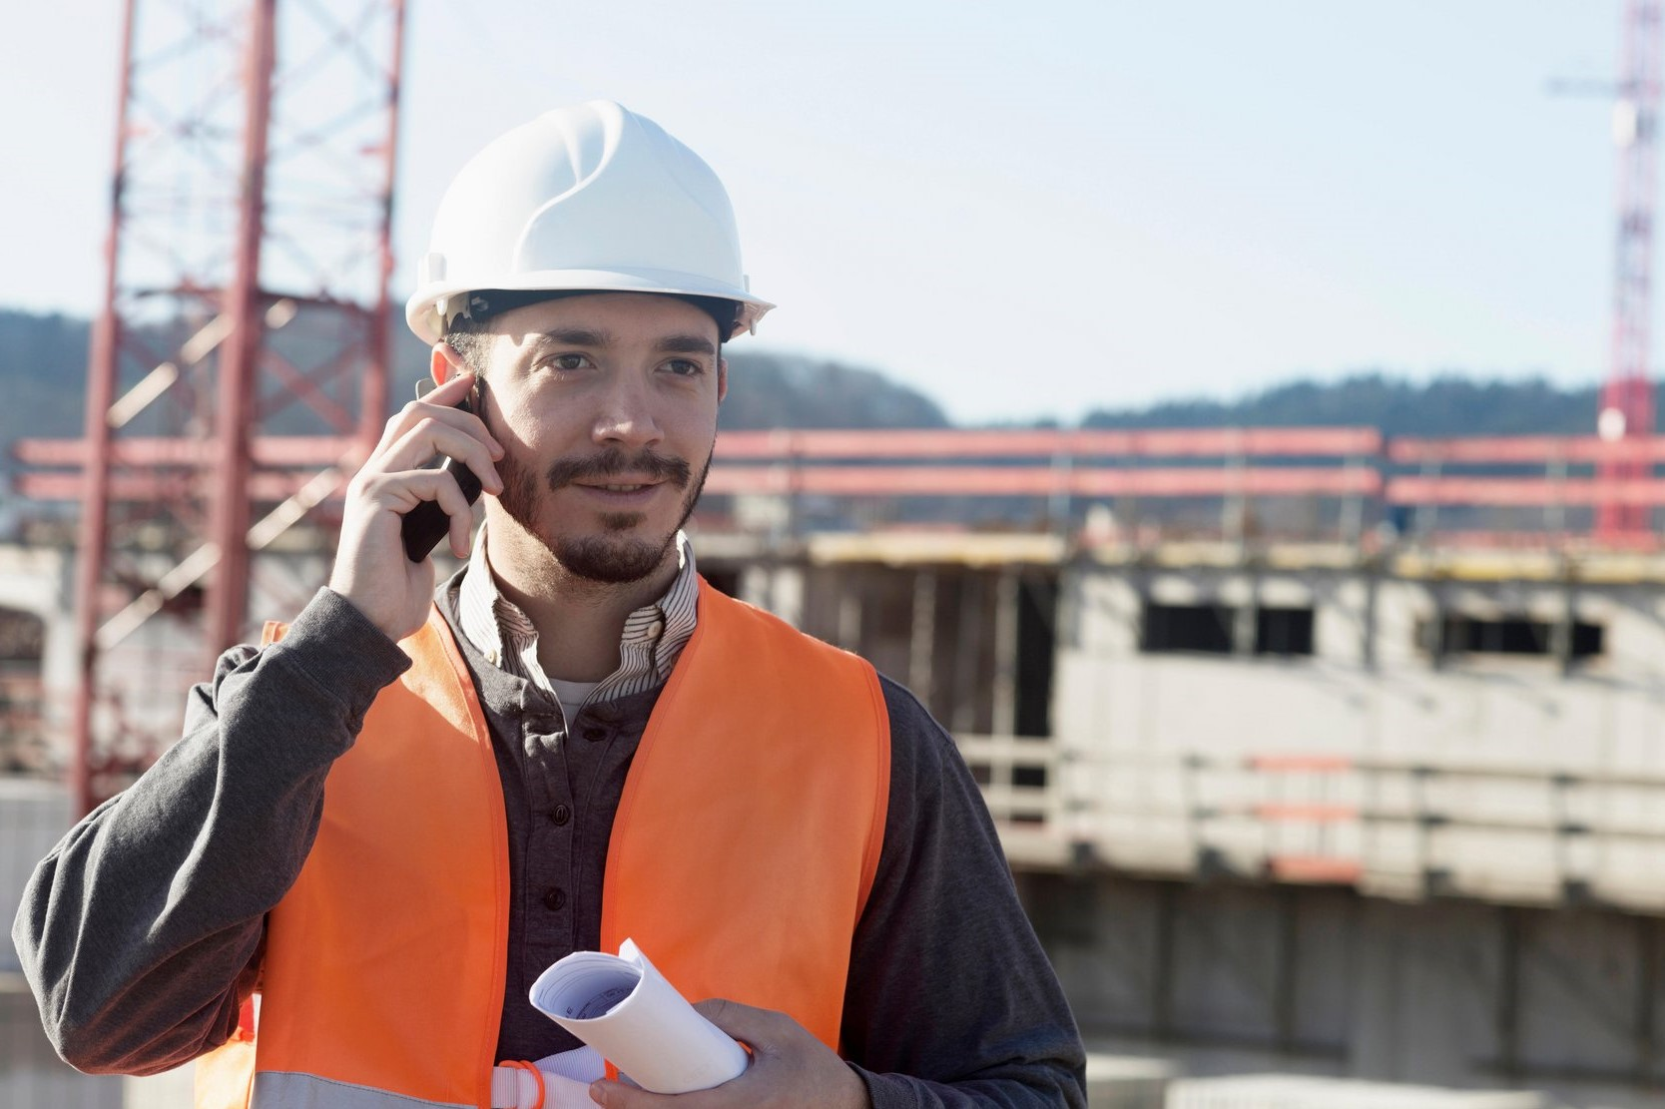
WHAT ARE THE BENEFITS TO YOU?
Save up to £200* per tonne by recycling waste rather than sending it to landfill or incineration.
Reduce your carbon footprint by using our EPD certified Proplex.
We can also collect your sub-contractors waste Proplex - a complete site solution.

Slide 8
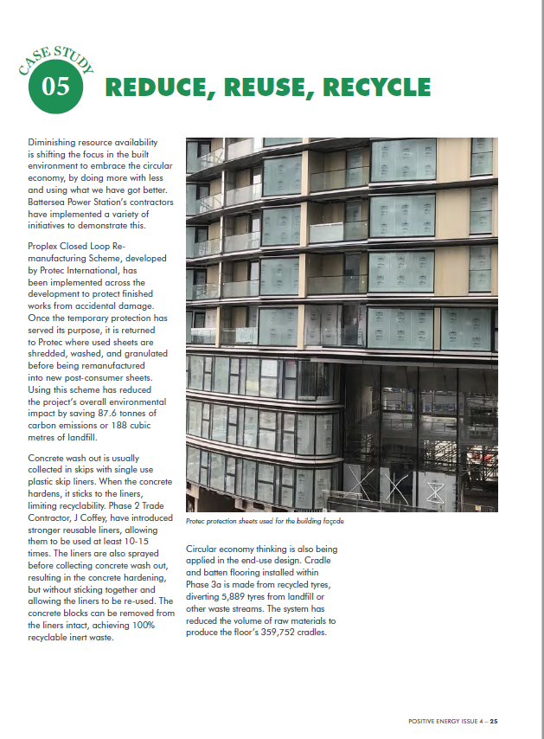
CASE STUDY 1:
BATTERSEA POWER STATION
PROJECT ACHIEVEMENTS
Reduced carbon emissions – 87.6 tonnes
Reduced waste to landfill – 188 cubic metres

Slide 9
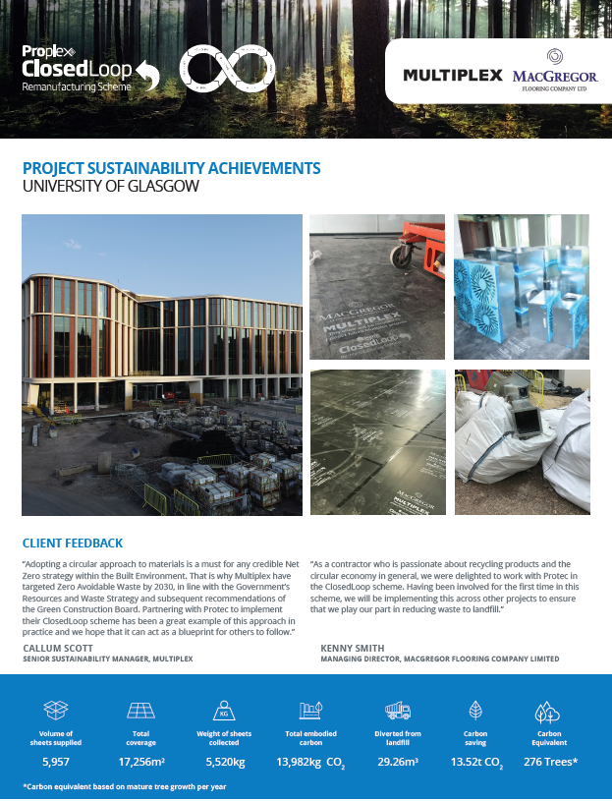
CASE STUDY 2:
UNIVERSITY OF GLASGOW
CONTRACTOR FEEDBACK
“As a contractor who’s passionate about recycling products and the circular economy in general, we were delighted to work with Protec in the ClosedLoop scheme. Having been involved for the first time in this scheme, we will be implementing this across other projects to ensure that we play our part in reducing waste to landfill.”
“Adopting a circular approach to materials is a must for any credible Net Zero strategy within the Built Environment. That is why Multiplex have targeted Zero Avoidable Waste by 2030, in line with the Government’s Resources and Waste Strategy and subsequent recommendations of the Green Construction Board. Partnering with Protec to implement their ClosedLoop scheme has been a great example of this approach in practice and we hope that it can act as a blueprint for others to follow.”

